Slide 1
Scala Code Coverage & Scala Style Checker
By Atanas Kuzmanov

Slide 2

Scoverage
What is code coverage?
Code coverage is a measure used to describe the degree to which the source code of a program is tested by a particular test suite.
Benefits
Tells you which parts of your codebase have not been covered by unit tests, thus helping you avoid potential bugs in production.
Platform independent
Not IDE specific
It’s not a cure for all!
Covered code does not mean good code. Code coverage does not tell you anything about the quality of the code.
100% coverage does not mean 100% tested. Two different test cases may achieve exactly the same coverage but the input data of one may find an error that the input data of the other doesn’t.
Scoverage vs. SCCT
Scoverage has more contributors and support
SCCT has a problem with Chrome
If you are trying to develop and test your application in Google Chrome on your local machine, an AJAX application using jQuery or offline javascript/html applications, Google Chrome browser will not load local file by default due to security reason.
To get around you will need to start Chrom with this flag: --allow-file-access-from-files

Slide 3
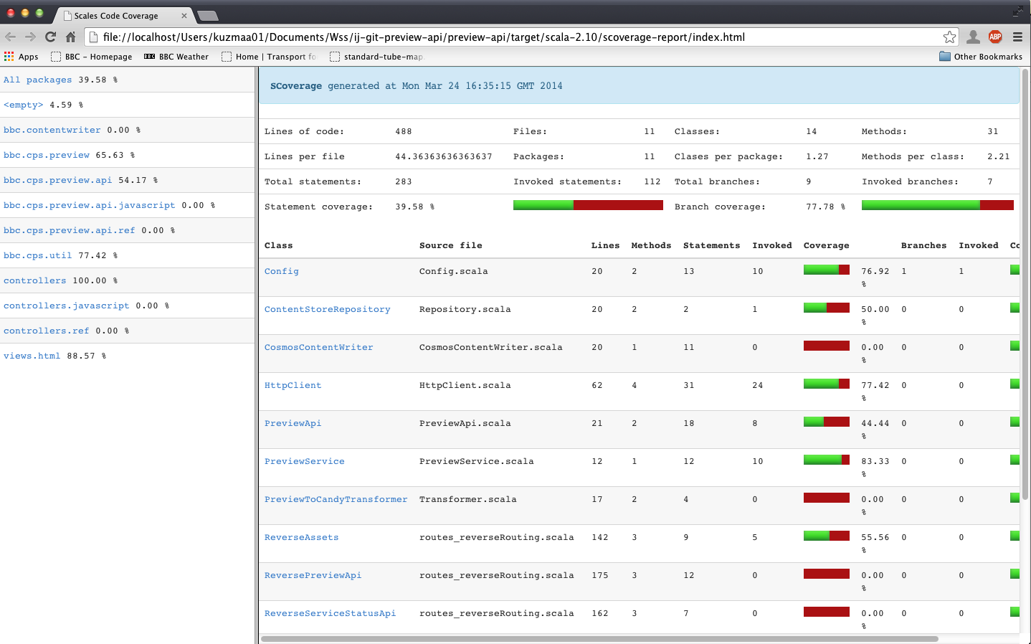
Scoverage Screenshot

Slide 4
Scala Style Checker
Scalastyle examines your Scala code and indicates potential problems with it.
Benefits
Can be used to help good code writing style
Ability of creating your custom own rules. This can be synchronized with the "CPS Team Scala Coding Conventions and Best Practices Guide" to help to comply with good programming practices which improve the code quality, readability, re-usability, and in an indirect way reduce the cost of development.
Cross-platform
Not IDE specific
Things to keep in mind
Performed checks mainly limit themselves to the presentation and don't analyze content, and do not confirm the correctness or completeness of the program.
It can be tedious to comply with all the style constraints, some of which could possibly harm the programming dynamic; so, it may be useful to determine what level of check is needed.
Do not overdo it, as it can have the opposite effect, moderation is the key.

Slide 5
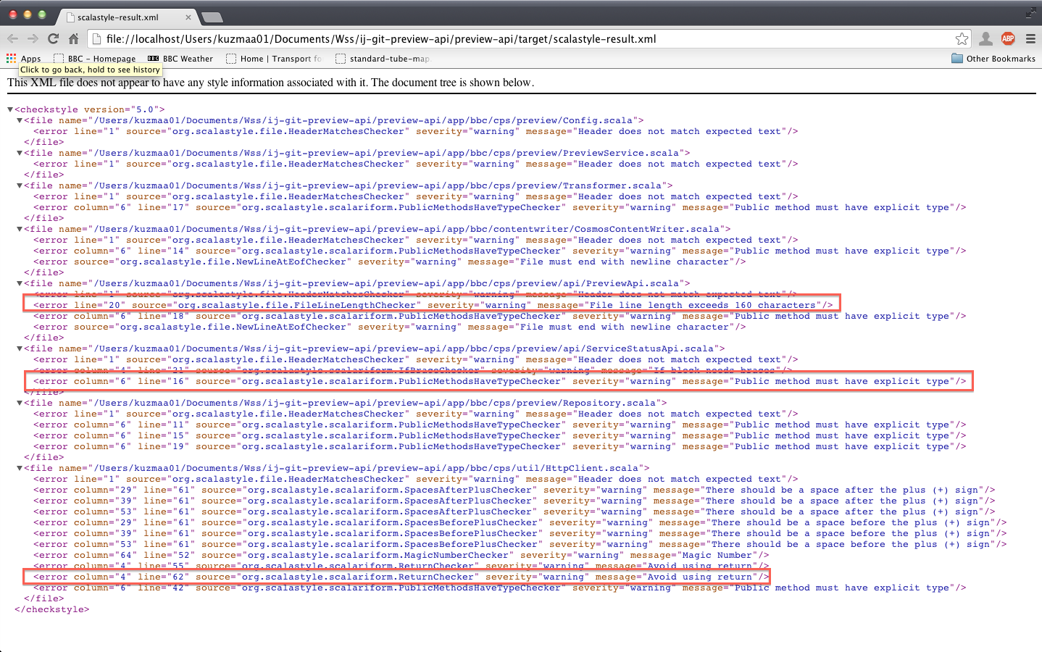
Scala Style Checker Screenshot

Slide 6



Vivo
Currently integrated with Preview-API and CPS-Rendering Library
But why integrate with Vivo, new technology, just for the sake of new technology is not always a good thing?
Benefits for Vivo
If integrated with Vivo sooner rather than later, these technologies will help
Give visibility to potential problems
Add the previously stated benefits early on
It will be easier to catch up with the code base before it has grown significantly

Slide 7
Further information
Further details and discussions will be held in the developer meetings on:
Code Coverage – Scoverage
Scala Style Checker
CPS Team Scala Coding Conventions and Best Practices Guide

Slide 8
References & Resources
http://en.wikipedia.org/wiki/Code_coverage
http://istqbexamcertification.com/what-is-test-coverage-in-software-testing-its-advantages-and-disadvantages/
https://github.com/scoverage
http://www.scalastyle.org/
http://en.wikipedia.org/wiki/Checkstyle
http://www.chrome-allow-file-access-from-file.com/
https://confluence.dev.bbc.co.uk/display/cps/CPS+Team+Scala+Coding+Conventions+and+Best+Practices+Guide

Slide 9
THE END
Thank you!
Questions?

